Slide 1
FYP Presentation
SCSE20-0940
Open-source intelligence gathering and analysis of correlation of cyber risks
Aloysious Foo
U1822019J

Slide 2
Contents
Introduction
Methodologies
Results
Conclusion
Limitations

Slide 3
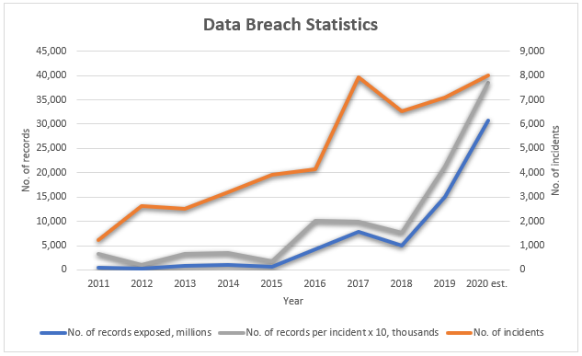
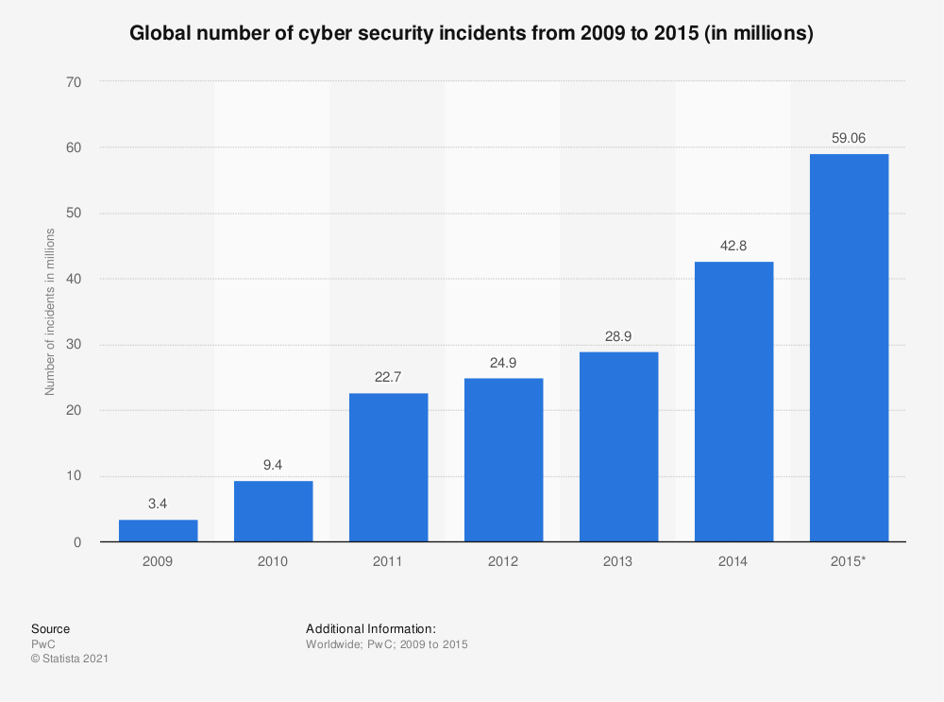
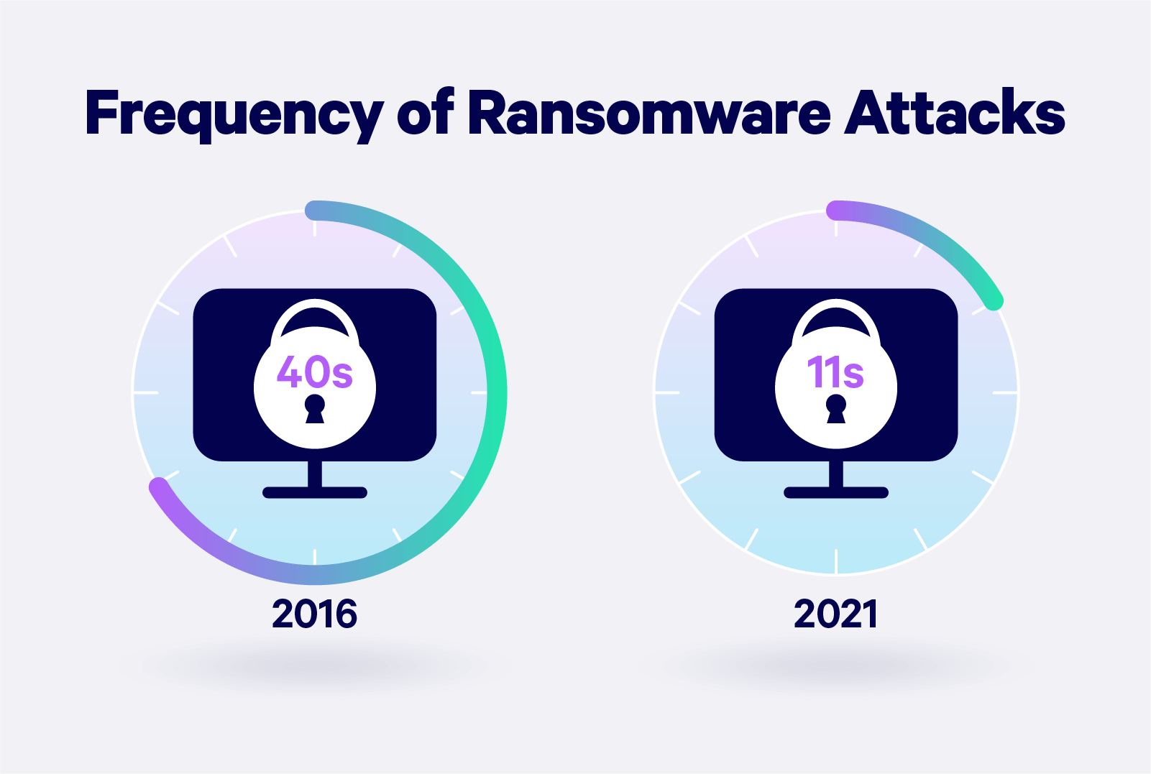
Introduction
Rise of cyber activity
Cyber Attack:
A malicious act online that compromises data, operations
Exist as part of today’s society
Unable to eradicate in a digitalized world
Continuously growing and spreading
Source: Risk-Based Security
Source: Statista
Notes:
Cyber attacks are malicious acts on the internet that compromise the privacy of digital data and its everyday operations. It is not an uncommon topis of today as it exist in most of the world.
From online cyber data stats we can see that cyber activity is continuing to rise over the years and it has come to a point where it cant be eradicated as we move to a digital world.
It will also continue to grow with the existence of the internet.

Slide 4
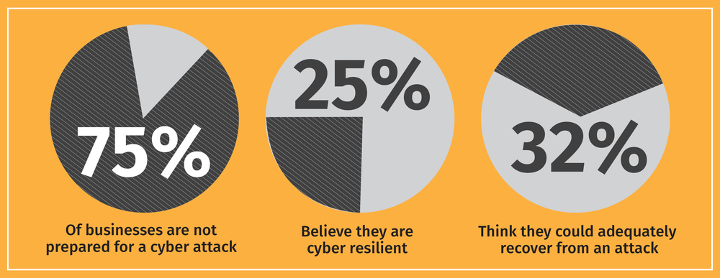
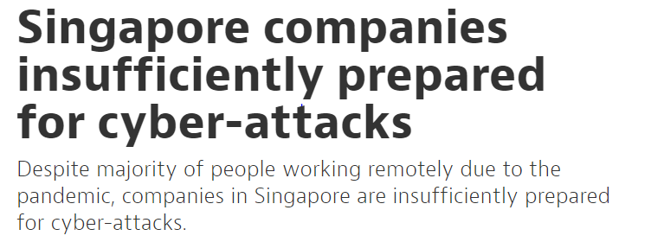
Living with cyber threats
Study and surveys shown many companies ill-prepared in the event of a cyber attack
Do not know what to do / No plans during/after cyber event
Only realise the consequence when they become the victims
Source: cyberint
Notes:
Although cyber threats are very commonly heard, many are unprepared and don’t know wad to do in the event of a cyber attack
And studies have shown that many organisations do not have proper plans to deal with them which allows many attacks to be carried out successfully.
And they only start to realise the impact when they are hit by them which is an issue that needs to be addressed.

Slide 5
Need for action
Requires understanding of cyber threats
Background research and study
Requires historical data and statistics
Raw data > Pictorial/Inferential
Goal:
Learn from past experiences to better manage risk
Notes:
In order to deal with cyber threats we need to be familiar with them in order to know what to do.
1 of it is to know what are the common threats, wad they do, wad they wan, who they target
This can be achieved by looking avaliable data, incidents and reports these data should also be shown in a way that that it is able to tell something and inferences can be made
So that we can learn something out of it

Slide 6
Outcome of project
Project task:
Find open-source data on cyber incidents
Project objective:
Identify cyber trends
Gain information on cyber activity
Notes:
The task of this project is to conduct analysis and visualisation on openly available cyber incident data and the expected takeaway is to gain knowledge of the trends and information of cyber activity.

Slide 7
Methodologies
Intelligence gathering (Datasets)
Picking important info
Visualisation
Notes:
The project will be implemented by looking out available datasets and what kind of info shld be chosen to visualise and to make possible predictions on the data.

Slide 8
Intelligence gathering
Suggested information to obtain:
Category of attack
Victim demographics
Industry
Reputation
Revenue
Year of incident
Impact
Financial Loss

Slide 9
Datasets
Hackmageddon
Collection of cyber attack incidents
Chosen attributes: Attack frequency, attack and victim type, year
Veris Database(Vocabulary for Event Recording and Incident Sharing)
Open and free
Chosen attributes: Attack frequency, incident and victim type, year, average employee count, revenue, financial loss
Github Repository
Data breach spreadsheet
Chosen attributes: Attack frequency, type of breach and victim, year, records lost
Notes:
In this project, 2 different datasets are selected to conduct analysis.
Hackamgeddon: Collection of cyber attack incidents by a single author that is actively compiled by a single author
Veris: open and free repository of publicly-reported security incidents which ppl can contribute to the database
The 3rd one contains a spreadsheet of compiled data breaches on a github repository by a graduate student

Slide 10
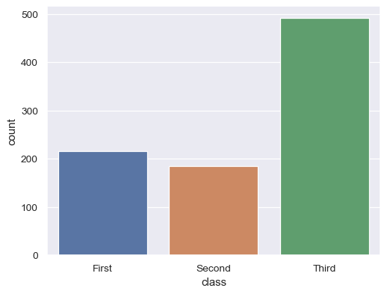
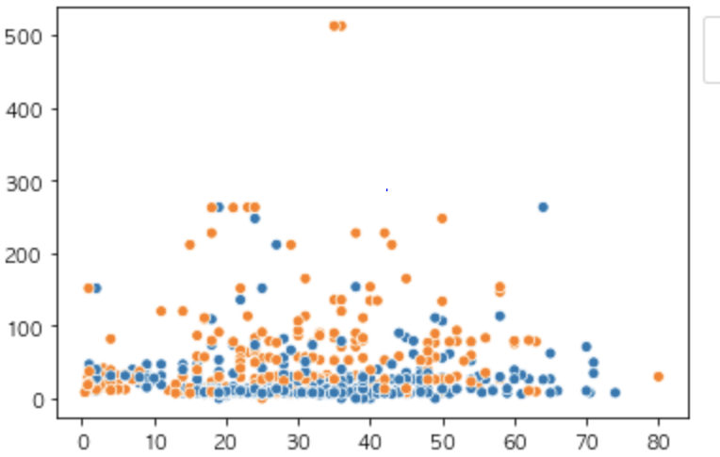
Methods of visualisation
Bar / Count plot
Scatter plot
Notes:
The methods used to visualise the data mostly done using 2 kinds.
1 Most are attributes are categorical data so I use countplots to visualise the distribution of the cateogory attribute
2 There are some visualisations that involve numerical against category so scatter is used

Slide 11
Predictive Modelling
Regression
Experiment | Predictor Variables | Response Variables
1 | Method of breach Type of industry Year of attack | Records lost from data breach
2 | Year of attack Attack type Average no. employee | Expected financial loss
Classification
Experiment | Predictor Variables | Response Variables | Rationale
1 | Year of attack | Type of industry | Trend of attack target over the years
2 | Financial loss | Type of attack | What attack cause the most damage
Notes:
Classification: look for a possible trend on how the targets of an attack change over the years
What attack cause the most damage

Slide 12
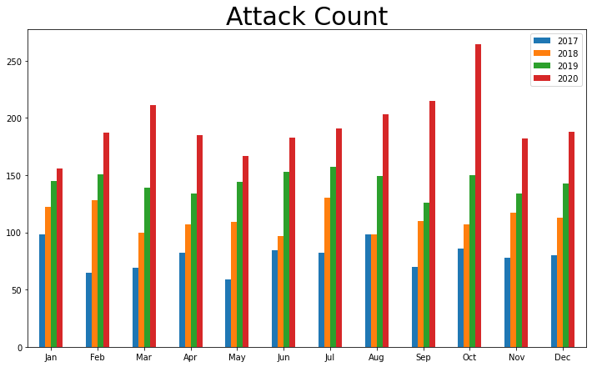
Results (Exploratory Analysis)
Hackmageddon dataset:
Frequency is on the rise
More hacking resource
More known vulnerabilities
Spike in 2020
Covid-19’s WFH motivates cyber attacks(e.g Phishing attacks)
Home networks less secure than corporate
Notes:
Frequency of attack over the past 4 years, as we can see there is an increase which shows that cyber threat is on the rise
Possible reasons: more open source tools, more vulnerabilities are known
Phishing trick users to click on malicious links(home internet may not be so secure like office)

Slide 13
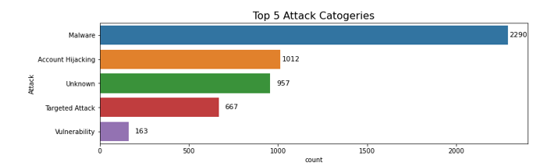
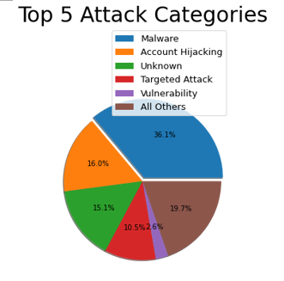
Malware most chosen form of attack
Free and easy to make
Profitable(e.g Ransomware)
Versatile, easily modified
Notes:
1 reason to use malware: free to make, very profitable, exist is many types, have different capabilities, is versatile

Slide 14
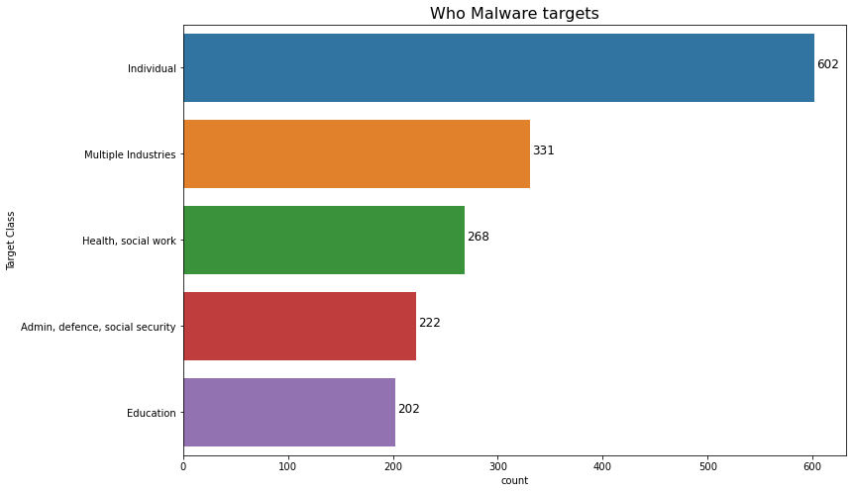
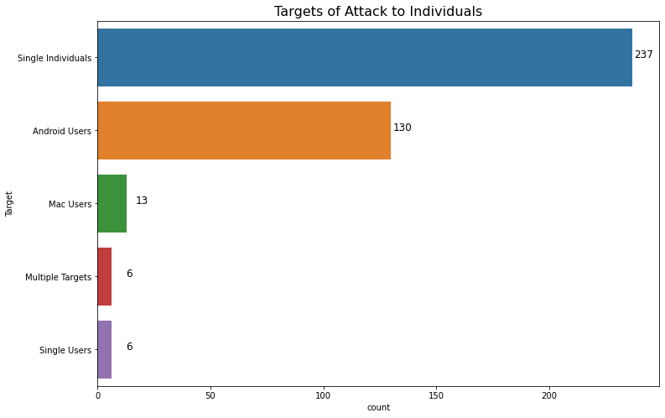
About Malware
Targets mostly people
Money(e.g Encrypts data)
Personal reasons(e.g Hatred)
Acquaintance(e.g Revenge)
Targets random people
Home users (e.g Personal accounts)
Android susceptible to security flaws
Open sourced
Develop exploits
Notes:
Mostly individuals: trying to personal attack for revenge
Single users: in the context of they are using a device
Single individual: mainly describing people(personal accounts) without any reference
seem to be about personal attacks

Slide 15
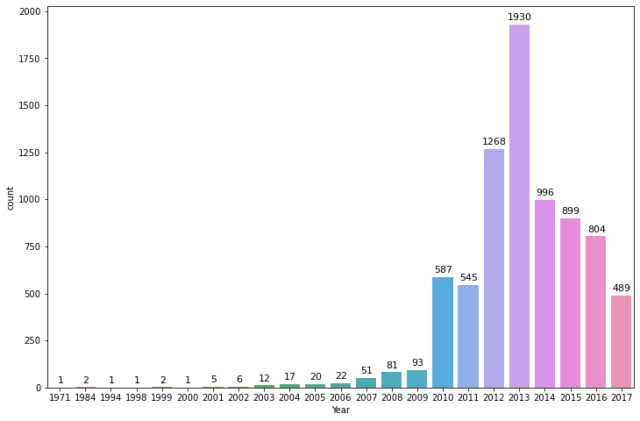
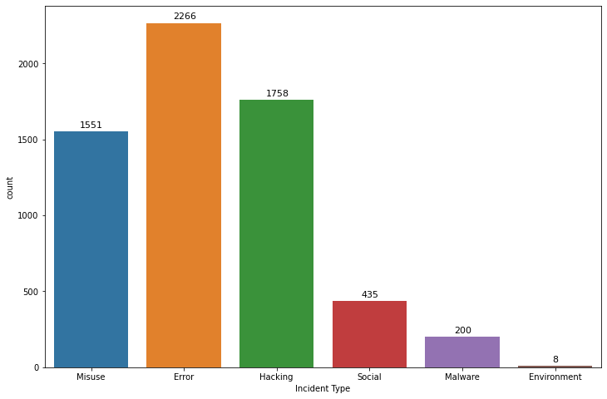
Veris dataset(Security incidents):
Hypothesis:
Large scale vulnerability / bug in 2010 that distributed over the world
Add on in 2013 and might contributed to the majority incident type of error
Notes:
2013 might have an event of a large scale vulnerability that lead to a rise in incidents
Explain error category, might be related to 2013

Slide 16
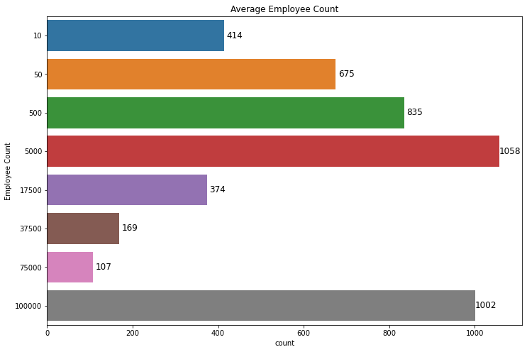
Most are big firms, possible reasons:
More profitable
Corporate Espionage
Notes:
From the emp count it can be seen that most are big companies with count>500 and it could be because they have more money and it is common for competition between big companies under the same industry and they might deploy spies to find out their operations and conduct attacks.
For emp count: acting as rival firm’s employee to steal data, money, personal attack someone they know

Slide 17
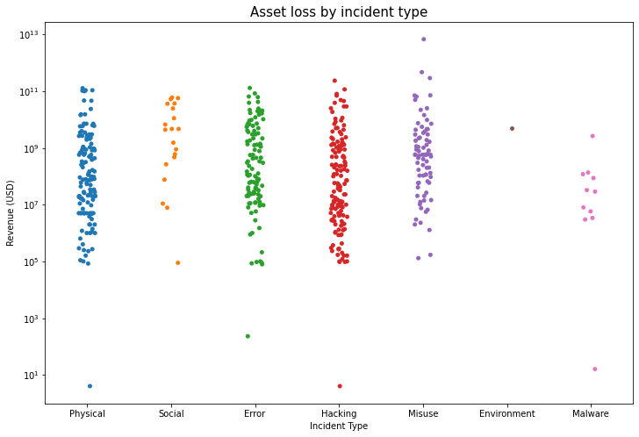
Outliers at the bottom may be due to minor issues
Test penetration/ Curiosity/ Boredom

Slide 18
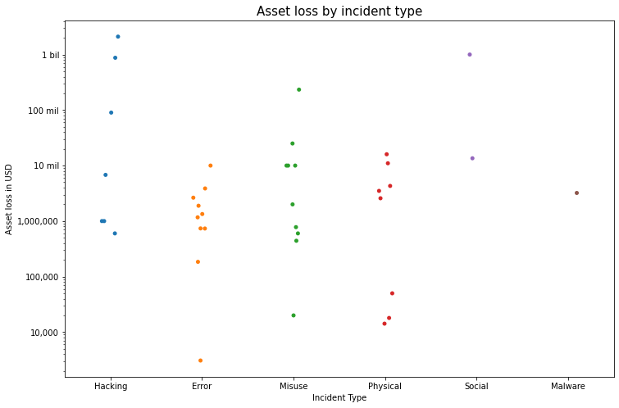
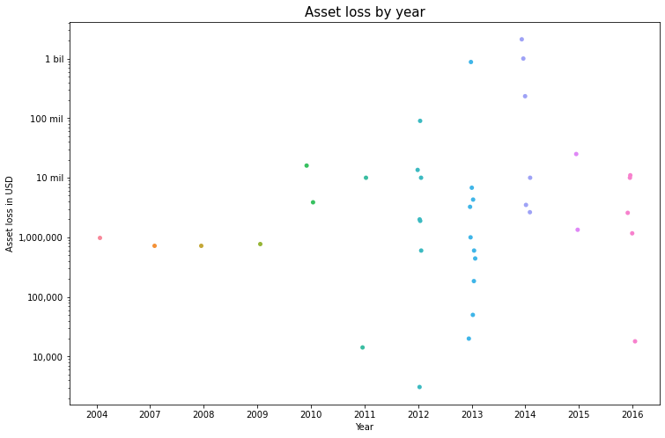
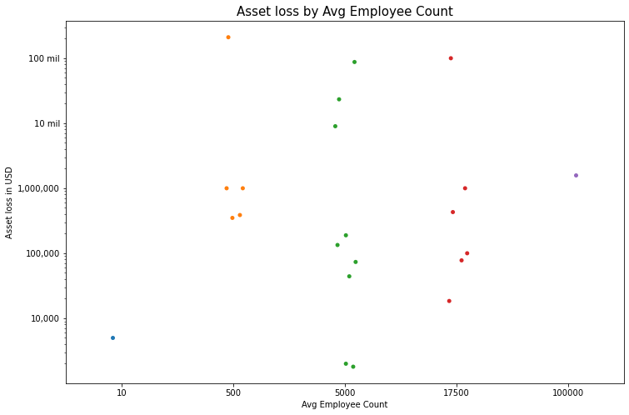
Huge range of losses
Money might not be primary motivation
No recognisable pattern
At least 100k losses under hacking
Most happen between 2011-2016
Notes:
No recognisable pattern from the scatters so it can be seen that the stats can be random

Slide 19
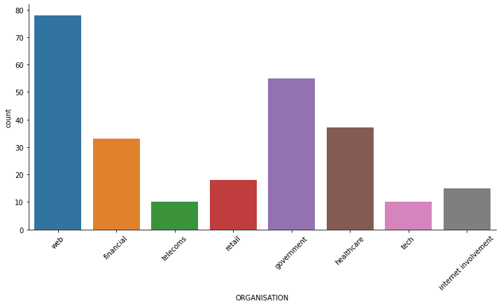
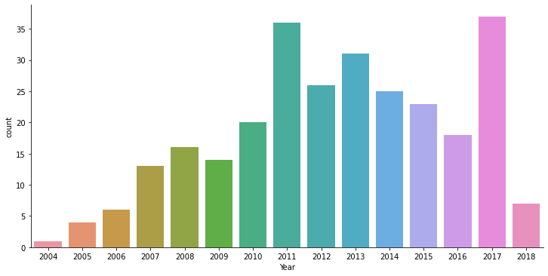
Github Databreach
Websites are resource-rich
Payment cards
Good advertising platforms
Distribute malware
Raise political issues
General rise due to growing trend living in digital world
Spike in 2011 and 2017 might be a govt law that cause unhappiness
Notes:
Web like ecommerce platform
Web=websites, internet involvement= anything other than web
Why target websites? 1) sensitive info, such as payments cards which are very valuable assets
2) websites are good platforms for distributing malware
3) good platforms for advertising, such as raise political/social issue, especially when targeting govt comes 2nd highest
2004-2011 increase reasons: rise in e payments, govt issue

Slide 20
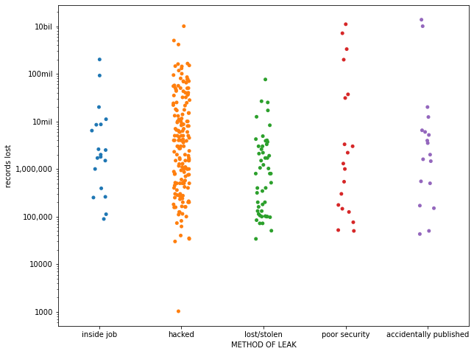
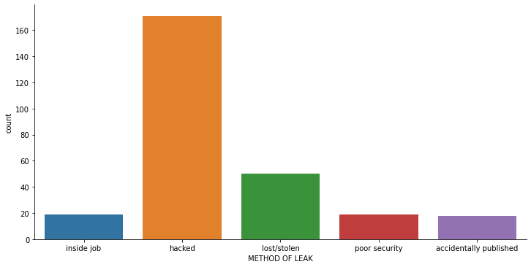
Hacking might be easiest/most convenient form of attack
At least 100k records, mostly targeting big companies
Issues related to society/govt

Slide 21
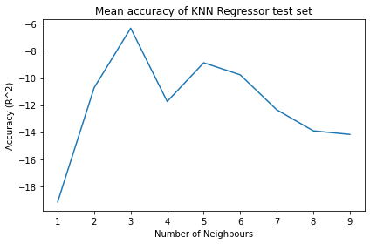
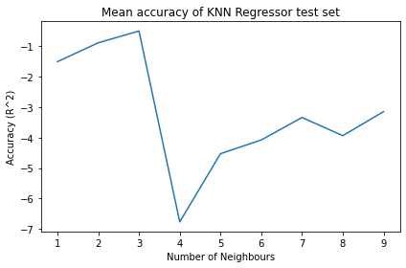
Predictive Modelling
Regression (K-neighbors)
Experiment | Accuracy(R^2) (Test size: 0.2) | No. of data
Predicting records lost | Train: 0.89, Test: -0.41 | 254
Predicting financial loss | Train: 0.99, Test: -2.9 | 39
Financial loss
Records lost
Notes:
Models failed as seen from the graphs of the test set (Negative accuracy)

Slide 22
Predictive Modelling
Classification
Experiment |  | Accuracy(R^2) (Test size: 0.2) | No. of data
Predictor | Response
Financial loss | Attack category | Train: 0.93, Test: 0.25 | 39
Year | Type of industry to be attacked | Train: 0.44, Test: 0.35 | 254
Overfitting, low accuracy
High cardinality
Insufficient training data

Slide 23
Conclusion
What can we learn from the datasets?
General rise of incidents over past decade
Mostly malware form of attack
Mainly for personal gains/attacks
Future actions
Need self educate on importance of cyber security
Conduct cybersecurity awareness training to educate staff
Preparation of actions in the event of cyber attack

Slide 24
Limitations
Scarce data with high cardinality
Poor machine learning performance
Year of attack used as predictor, unrealistic
Inferences are bounded to datasets
Reality may speak otherwise
Missing data could tell another story

Slide 25
----Q&A----

Slide 26
References
Data Breaches Continued to Rise in 2019 – WhamTech
Cyber security: global incidents 2015 | Statista
Survey Says: Companies are Ill-Prepared for Cyber Attacks – Cyberint
More than half of businesses are not prepared for Cyber Attacks - Cybersecurity Insiders (cybersecurity-insiders.com)
Singapore companies insufficiently prepared for cyber-attacks | HRM Asia : HRM Asia
2021 Must-Know Cyber Attack Statistics and Trends – Embroker(ransomware pic)

